Slide 1
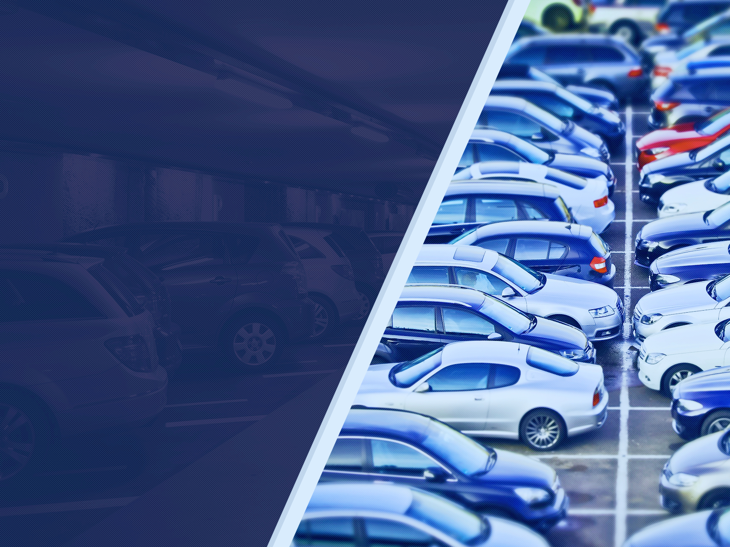



We Park
TEAM NUMBER:11
TEAM/PROJECT NAME: We Park

Slide 2
Managing The Parking Lot By A Smart Application
Problems:
Find an empty parking lot in the city/village.
The driver wastes time searching somewhere to park.
The driver wastes more fuel by searching a parking lot or an empty space to park his car.
The driver pays high cost for parking lot .
The driver stops their car at the edges of the street.
No one knows about private parking lots.
Inefficient use of existing parking capacity.

Slide 3
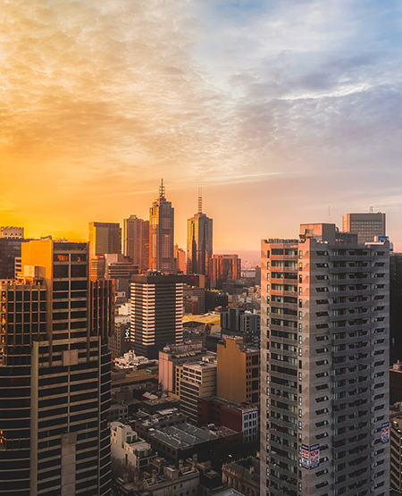
Need:
Empty parking slots in parking lot.
To find as fast as a parking lot.
Save time.
Reduce fuel consumption.
Sharing small private parking lots.
Location of parking lots.

Slide 4
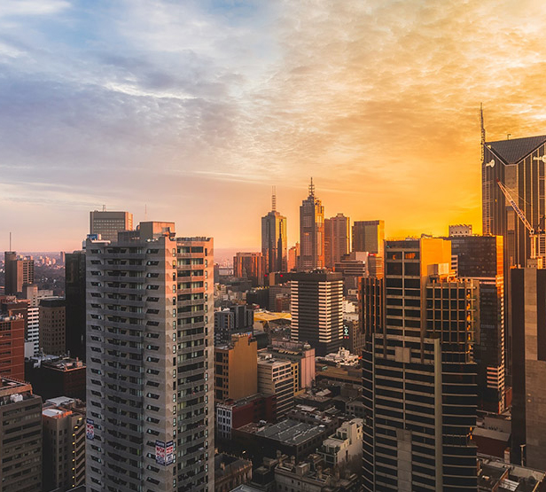
Why are we developing a solution?
To reserve paring spot for a car before it arrives .
Prevent the frustration of finding a parking spot.
Make a smarter city and parking lots.
low costs of parking fees.
Encourage use of intelligent parking system .
Saving time and fuel for drivers.
Parking space comparisons .
Parking capacity at real time.

Slide 5
Market
Addressable Target Audience
Our clients and our users
People that want to save time and fuel .
People that have a booking time at somewhere(doctor , restaurant ...).
People that visiting a place for first time.
Users that are familiar using a smartphones and have a credit card.
Clients that have a parking lots.

Slide 6
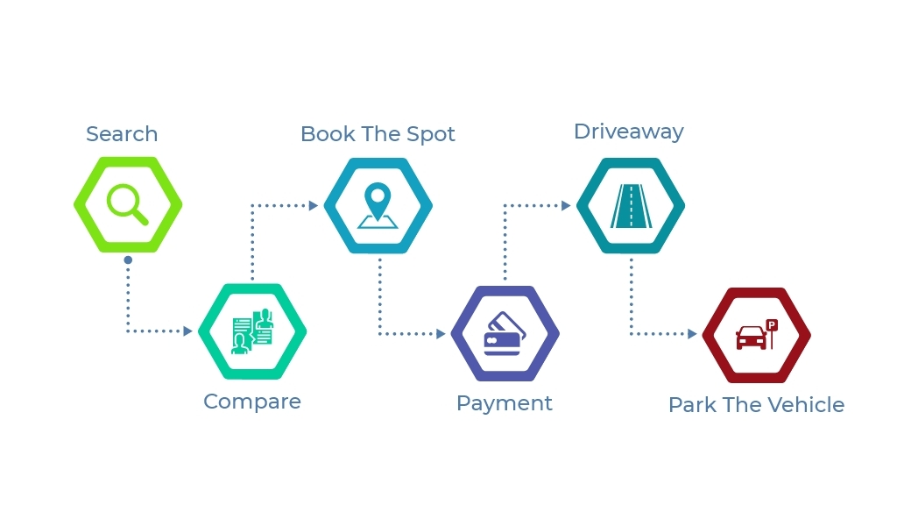
The solution
System and Flow-Chart
Start
All the spots are free and app shows the # of free spot.
We do an application for drivers to find an empty parking car lot as fast as they can, and they can see in real-time the capacity of the parking car lot and reserve a slot where to park.
Driver reserve one of the free spots.
NO
Did the driver make reservation ?
YES
the counter of this spot will show = X-1
Driver arrive the parking and the gate opens by camera image processing .
The gate will stay close and the #of free space stay = X
NO
Is this the reserving car ?
YES
The gate will open and its spot will count the # of free space = X-1
The # of spots will stay until leaving
NO
the reserving car leave the spot ?
YES
Thr counter will show the #of free spot increasing by 1
Finish

Slide 7
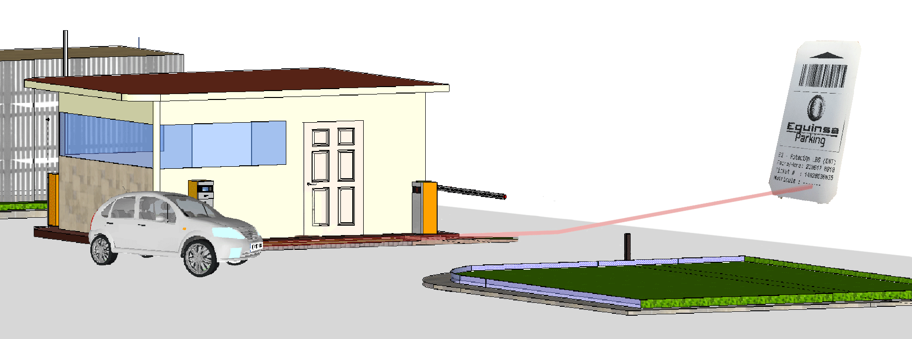
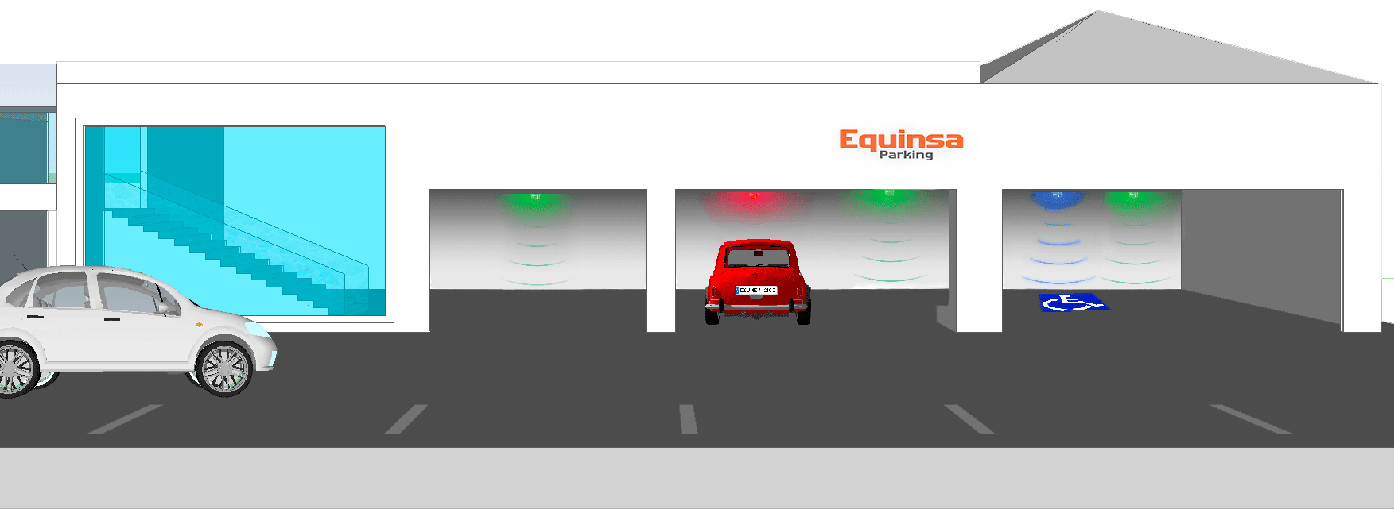
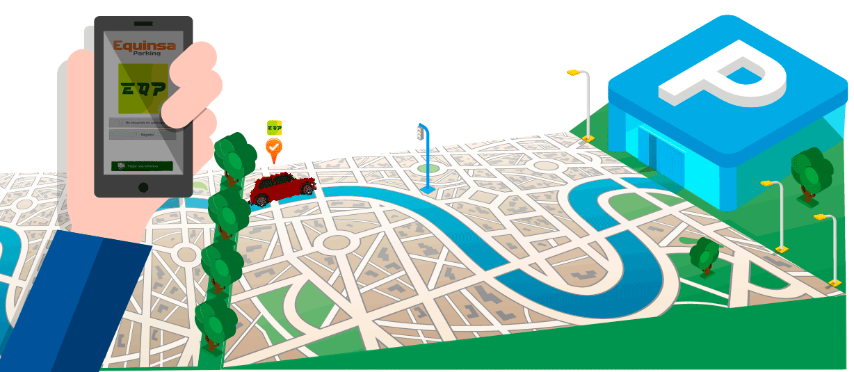

Slide 8
What makes our solution better or innovative?
We provide our customers with information on the nearest parking lot and, they can reserve a slot.
We giving an option to share every park in the world.

Slide 9
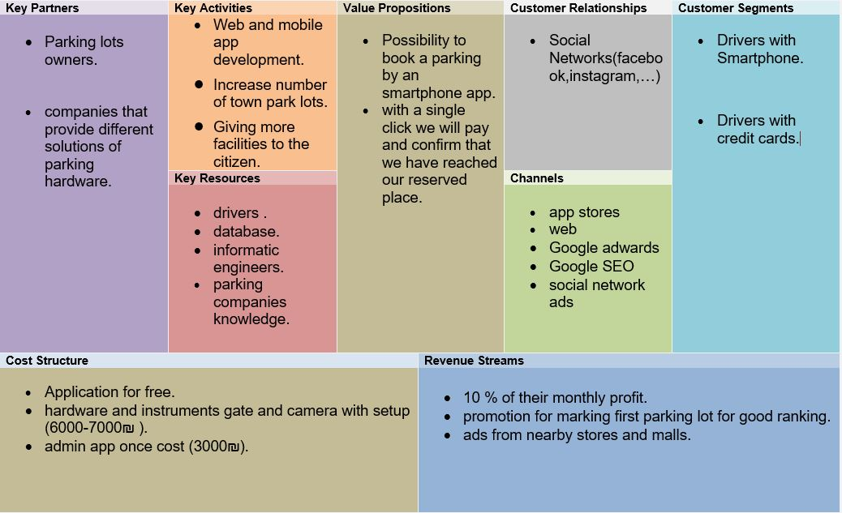
Business model

Slide 10
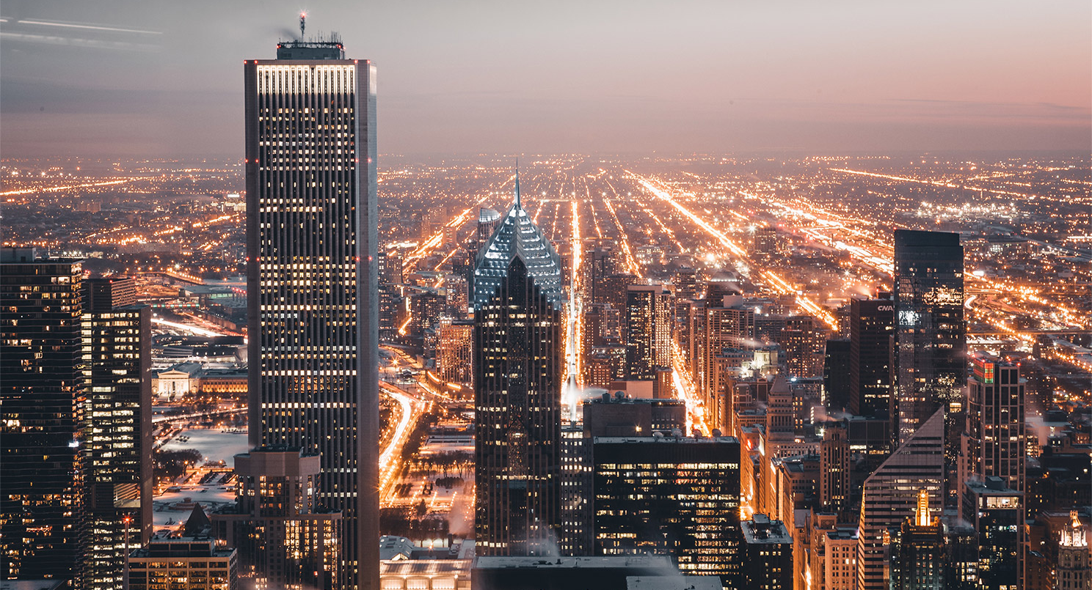
Future Features & Desserts
The app will work with bigger places and more parking lots.
The app will include a feature for ads and discounts d-coupons for located nearby stores.
The team will provide a smarter system for this parking lots with more advanced sensors and more features.
The app will do a promotion system and work with SEO to advertise parking lots.
The app will contain special vans parking lots for breaks .

Slide 11

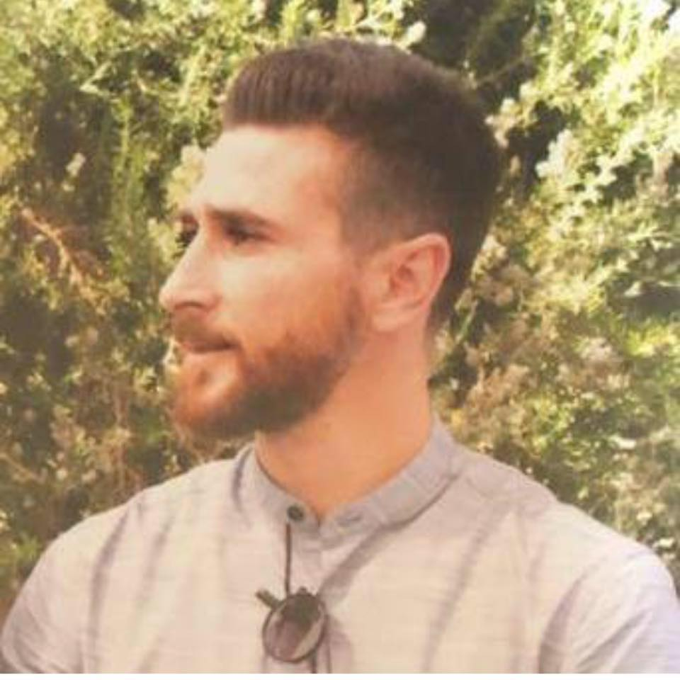
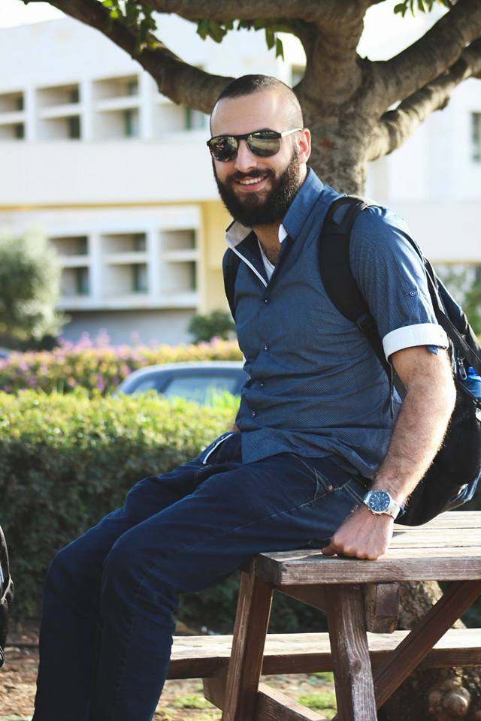
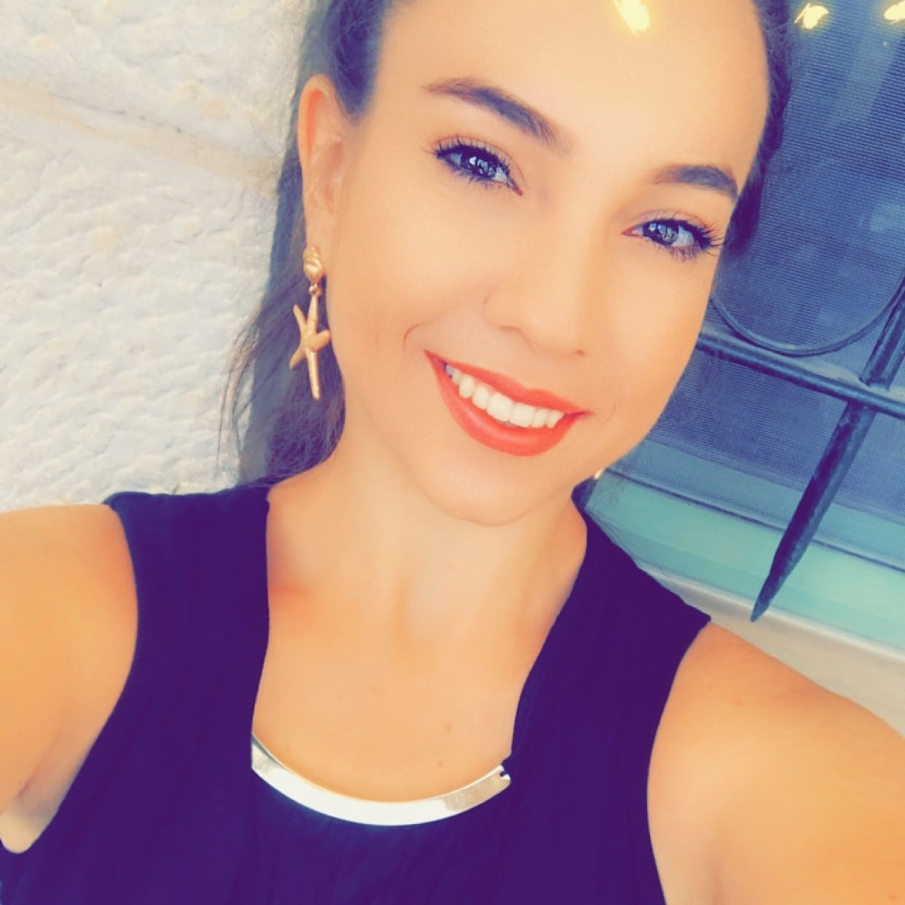

Thank You.
Omri Zaher
Marshood Ayoub
Nivin Abbas
Rasheed Hisham

